Slide 1

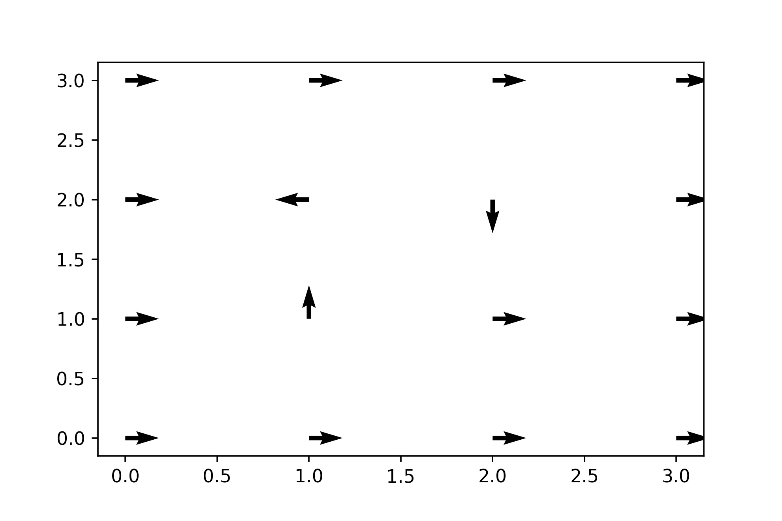
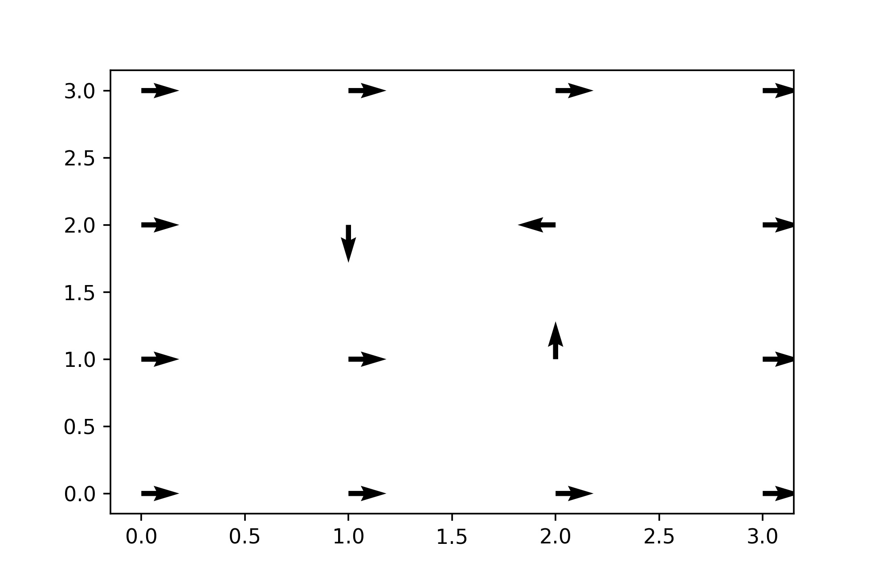
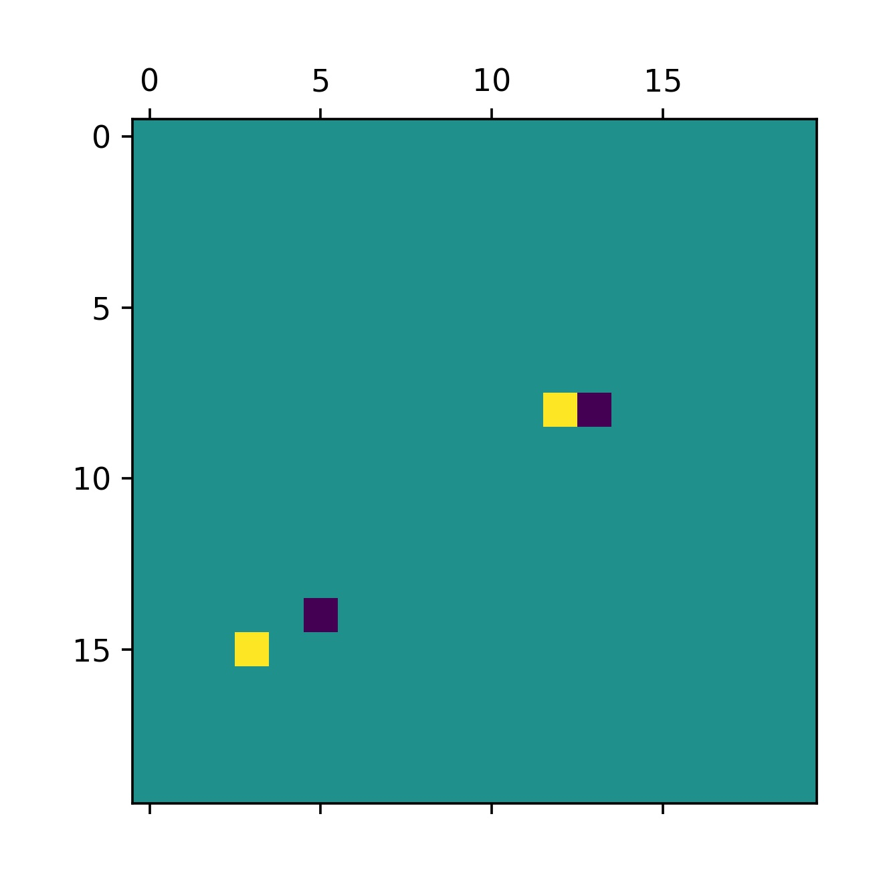
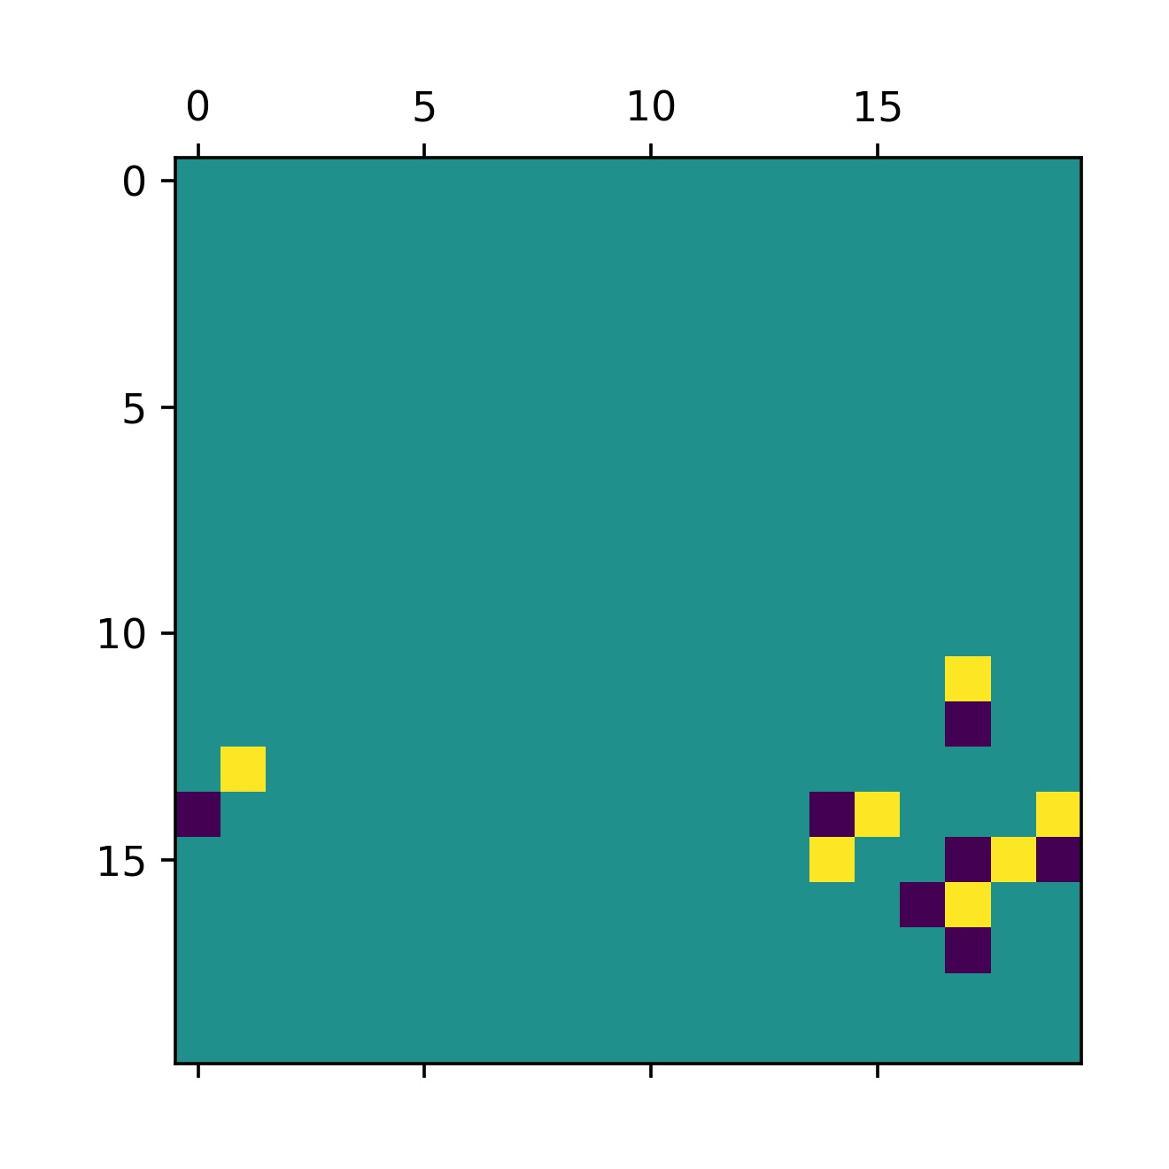
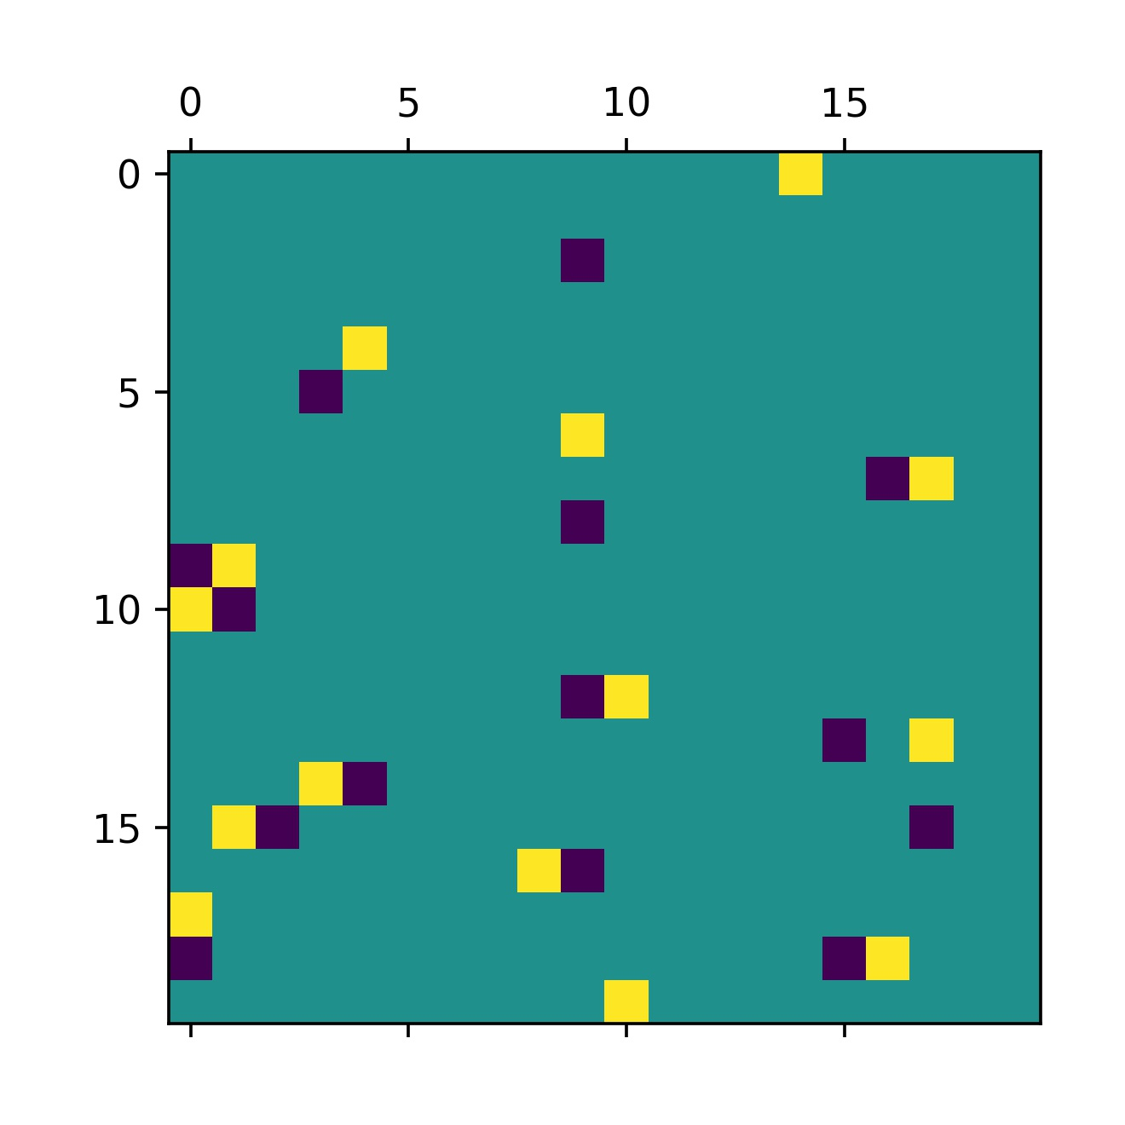
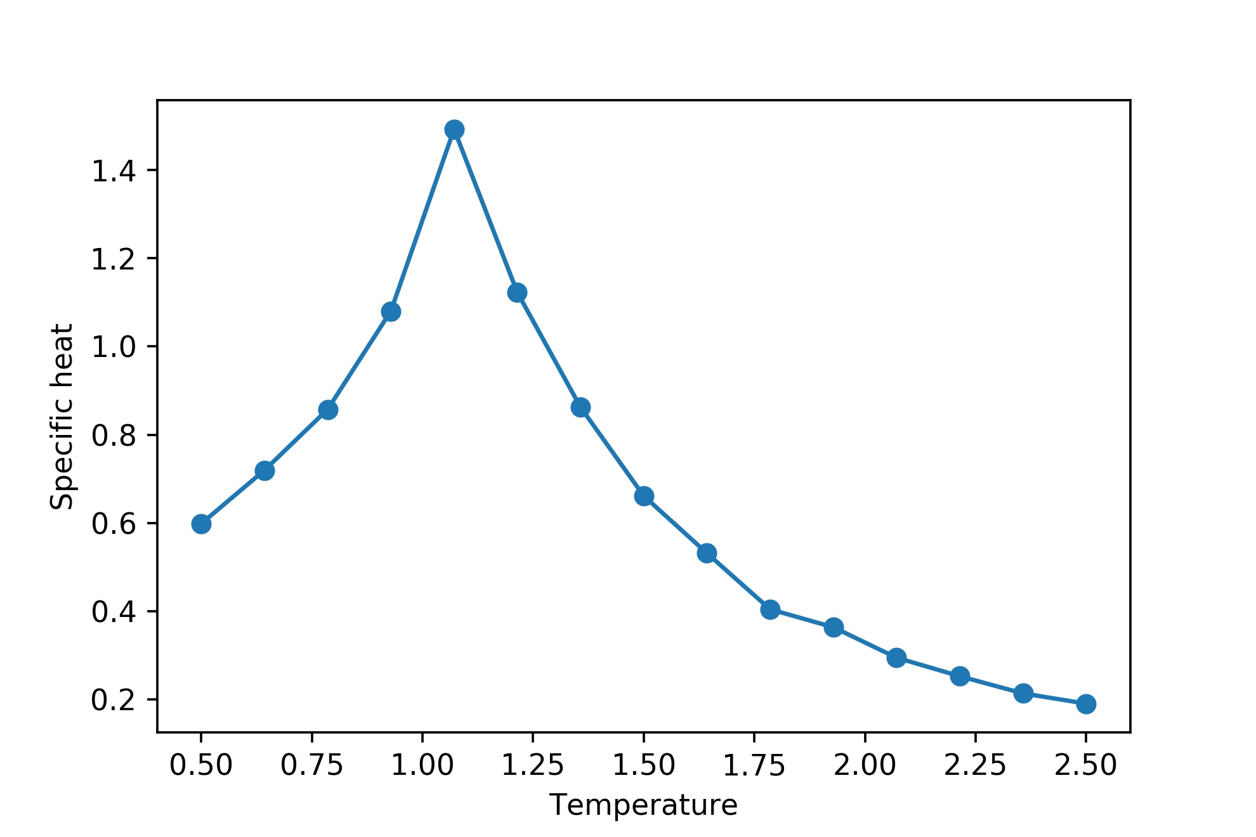
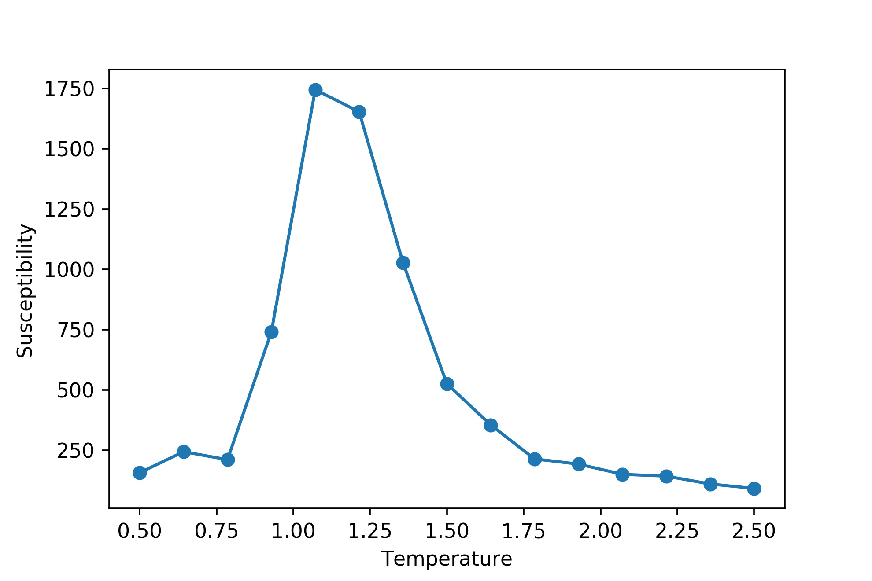
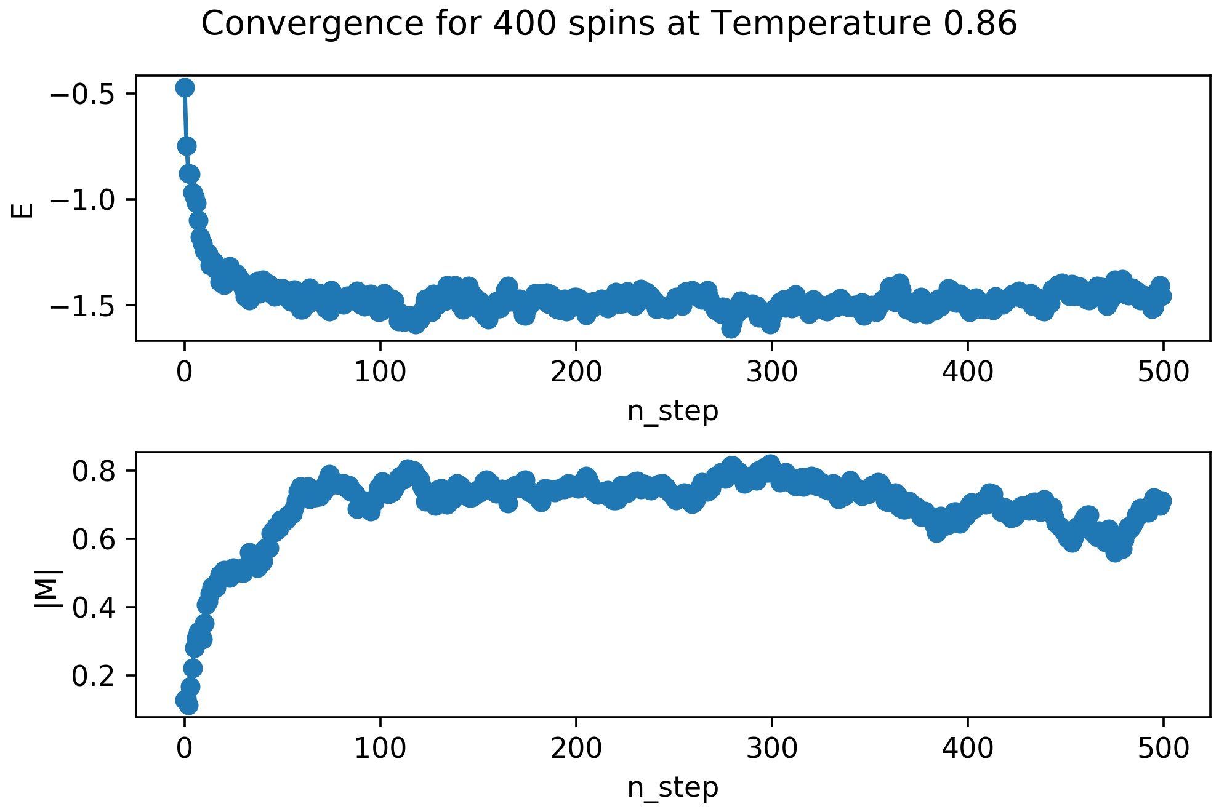
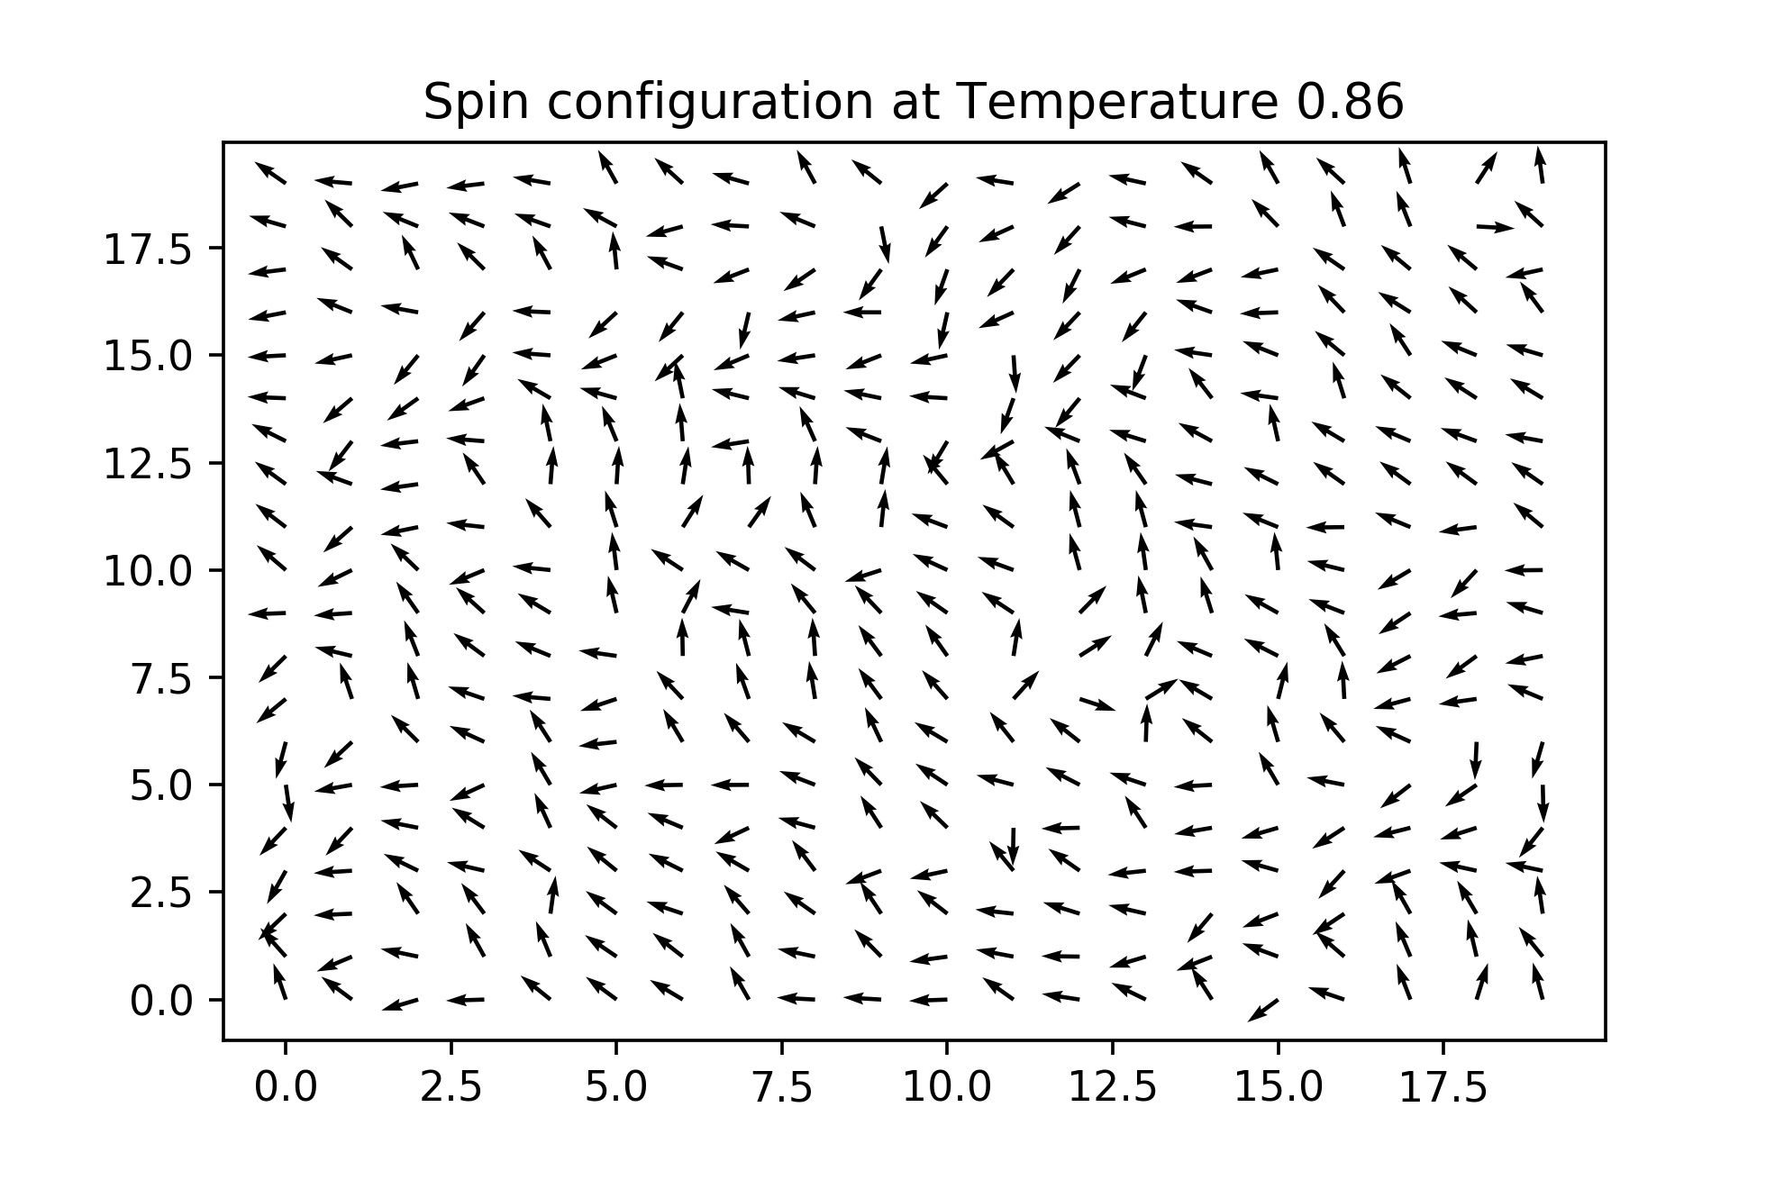




Towards Disorder in Two Dimensional XY Models on a Square Lattice
Amogh Waghmare (EP19B018) IDDD in Quantum Science and Technology Guide: Dr.Anil Prabhakar co-Guide: Dr.Rajesh Naraynanan
EE4902 Mini Project
Introduction
BKT Transition in XY model without disorder: Simulation
Effects of Disorder
The 2D XY model acts as a toy model to study an important class of phase transitions called the Berzinski-Kosterlitz-Thouless(BKT) Transitions. These model many 2D systems like
thin films of superfluids,
arrays of Josephson junctions
behavior of exciton-polaritons in semiconductor microcavities.
The increasing use novel effects in 2D systems for technological applications, like making efficient lasers out of exciton-polariton systems[1] or using Josephson junction arrays as quantum computers, makes the study of the BKT transition very important
Vortices are topological defects that involve spin configurations with a non zero curl, that is the line integral of the vector field representing spin direction is non zero along a closed loop. In the discreet case the sum of change in the angle of spins(constrained between $−π$ to $π$) around a loop becomes non-zero.
These vortices behave like charged particles living on a 2D surface with charge being proportional to their vorticity.
Many Systems follow a power law scaling near the critical point, that is the properties of the system like magnetization, specific heat etc. have a form:
$${\left(\frac{T−T_{c}}{T_{c}}\right)}^{γ}$$
The set of exponents $γ$ are same for a wide variety of systems irrespective of their microscopic details. Such systems are said to be the part of the same universality class.
Presence of disorder in a system can change its universality class, make the power law exponents $γ$ disorder dependent or change the power law scaling to a logarithmic scaling
For an one dimensional array of Josephson junctions, Altman and Refael [2] have shown that disorder can make the systems critical exponents disorder dependent.
Since a classical 2D XY model with correlated disorder(coupling constants vary randomly in one direction but are perfectly correlated in the other) can be mapped to this system[3], we can use Monte-Carlo simulations to study the details of this crossover from normal exponents to disorder dependent exponents.
The 2D XY model
the microscopic Hamiltonian for the model is given by
$$H=−\sum_{\left\langle ij\right\rangle }{J_{ij}{\vec{s}}_{i}}⋅{\vec{s}}_{j}$$
Where the sum is over the nearest neighbors and $\vec{s}$ are 2D unit vectors representing the direction of the spins, and J is a positive number representing the strength of coupling between the two spins
The coupling strength $J_{ij}$ is drawn from a probability distribution which models the disorder in the system
An antivortex
A vortex
The BKT transition describes the topological phase transition from a low temperature where the vortices are tightly bound to a high temperature phase where they are free
Conclusions and Future work
Methods
We have been able to simulate the BKT phase transition for a 2D XY model on a square lattice using classical Monte-Carlo methods. Vortex unbinding has also been observed as temperature is raised.
We plan to introduce correlated disorder in our Monte-Carlo simulations and try and reproduce the results of Fawaz and Voijta[3]
We also want to extend these results by investigating the effects of disorder on the rate of vortex formation in a thermal quench in this 2D XY model and look for an analogous quench for the one dimensional Josephson junction model.
(a)
(b)
(c)
The standard Metropolis algorithm is used to calculate various equilibrium properties and dynamics of the 2D XY model on a 20x20 square lattice with a constant $J$ and periodic boundary conditions.
A random change in spin direction is accepted with a probability of $\exp\left(\frac{−ΔE}{k_{b}T}\right)$if the new configuration is energetically unfavourable, and is always accepted if the change causes lowering of energy.
In a single Monte-Carlo sweep there is an attempt to kick each spin in the lattice into a new direction once. The system is allowed to come to equilibrium by allowing about 2000 such sweeps.
Position of vortices for T=0.89 (a), T=1.095 (b) and T=1.026 (c)
At low temperatures, vortices (represented in yellow) and anti-vortices (represented in purple) are low in number and are tightly bound. As the temperature increases across the critical temperature, a large number of vortices(vorticity remains zero) are generated which interact with each other, making the notion of pairing weak.
References
Fraser, M., Höfling, S. & Yamamoto, Y. Physics and applications of exciton–polariton lasers. Nature Mater 15, 1049–1052 (2016)
E. Altman, Y. Kafri, A. Polkovnikov, and G. Refael, Phys. Rev. Lett. 93, 150402 (2004); Phys. Rev. B 81, 174528 (2010).
F. Hrahsheh and T. Vojta, Disordered Bosons in One Dimension: From Weak-to Strong-Randomness Criticality, Phys. Rev. Lett. 109, 265303 (2012)
Monte Carlo study of the planar spin model: Tobochnik and Chester
A guide to Monte-Carlo Simulations in Statistical Physics: Landau and Binder
Jelic, A., & Cugliandolo, L. F. (2010). Quench dynamics of the 2d XY model. arXiv. https://doi.org/10.1088/1742-5468/2011/02/P02032
Plots of specific heat and the susceptibility of the system also shows peaks at the temperature around which vortex pair unbinding starts, showing the presence of a phase transition.

